Slide 1
Department of Applied Mathematics and Computational Sciences
III Sem M.Sc.Software Systems
Transform Techniques
Dr. V. Suresh kumar

Slide 2
Periodic function

Slide 3
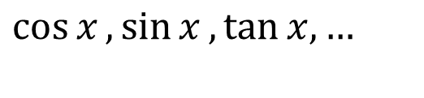
Example
Definition
A function $f\left(t\right)$ is said to be periodic function with period $p$, if $f(t+p)=f(t)$.
$$\cos{x},\sin{x},\tan{x,…}$$
Note
If the function $f\left(t\right)$ is periodic with period $p$ then $f(t)$ is of periodic with period $np, n∈Z^{+}.$

Slide 4
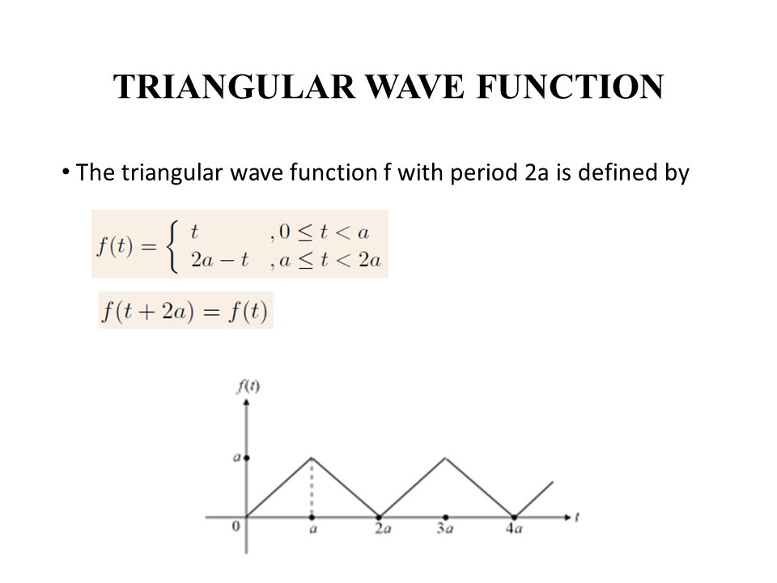
Examples cont…

Slide 5
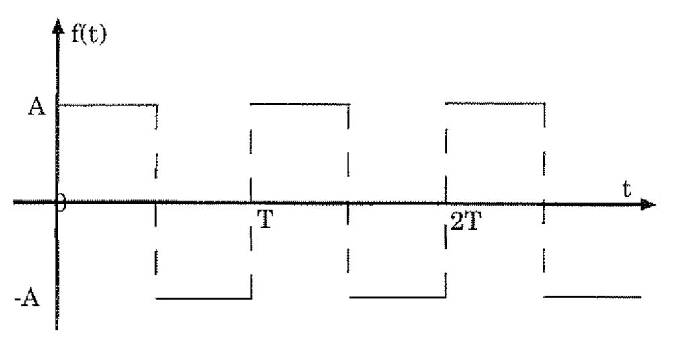
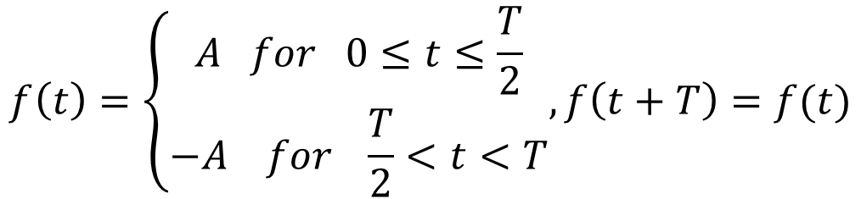
Examples cont…
$$f\left(t\right)=\left\{\begin{aligned}A for 0≤t≤\frac{T}{2} \\ −A for \frac{T}{2}<t<T\end{aligned}, f\left(t+T\right)=f(t)\right.$$
Rectangular wave function

Slide 6
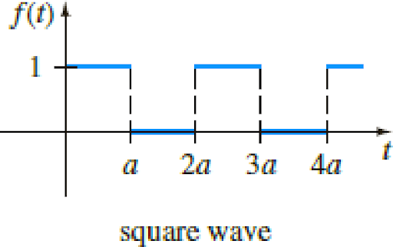
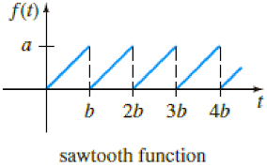
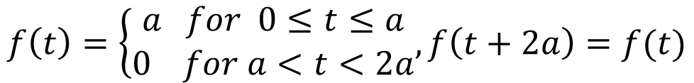

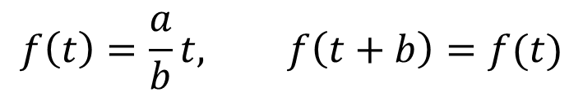
Examples cont…
$$a$$
$$f\left(t\right)=\left\{\begin{aligned}a for 0≤t≤a \\ 0 for a<t<2a\end{aligned}, f\left(t+2a\right)=f(t)\right.$$
$$f\left(t\right)=\frac{a}{b}t, f\left(t+b\right)=f(t)$$

Slide 7
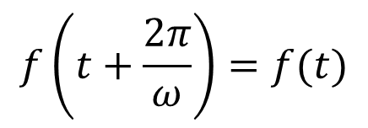
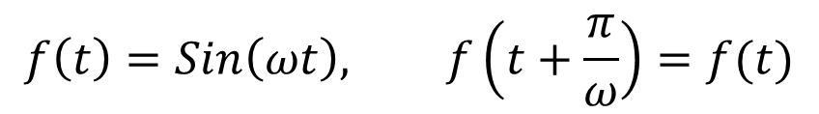
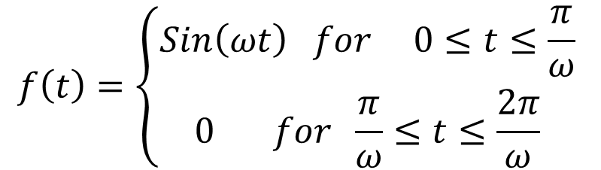
Examples cont…
$$f\left(t\right)=\left\{\begin{aligned}Sin\left(ωt\right) for 0≤t≤\frac{π}{ω} \\ 0 for \frac{π}{ω}≤t≤\frac{2π}{ω}\end{aligned} \right.$$
$$f\left(t+\frac{2π}{ω}\right)=f(t)$$
$$f\left(t\right)=Sin\left(ωt\right), f\left(t+\frac{π}{ω}\right)=f(t)$$

Slide 8
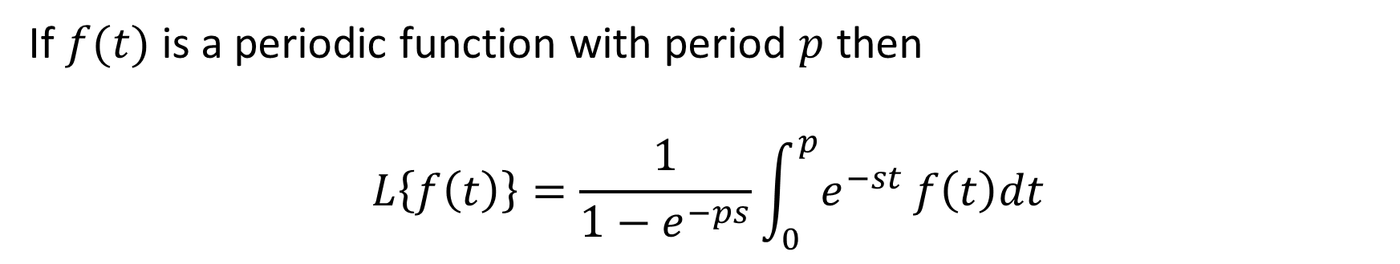
Transform of periodic function
If $f(t)$ is a periodic function with period $p$ then
$$L\left\{f\left(t\right)\right\}=\frac{1}{1−e^{−ps}}\int_{0}^{p}{e^{−st}}f\left(t\right)dt$$

Slide 9
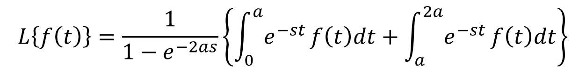
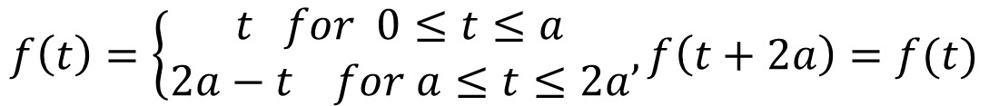
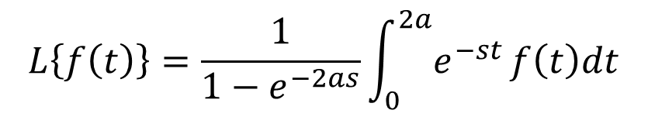
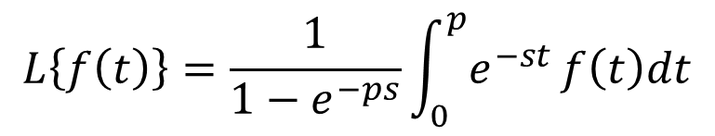
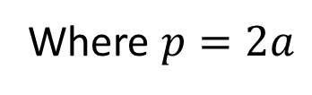
Example
1. Find the Laplace Transform of Triangular wave function
Ans:
We have
$$f\left(t\right)=\left\{\begin{aligned}t for 0≤t≤a \\ 2a−t for a≤t≤2a\end{aligned}, f\left(t+2a\right)=f(t)\right.$$
and
$$L\left\{f\left(t\right)\right\}=\frac{1}{1−e^{−ps}}\int_{0}^{p}{e^{−st}}f\left(t\right)dt$$
Where $p=2a$
$$L\left\{f\left(t\right)\right\}=\frac{1}{1−e^{−2as}}\int_{0}^{2a}{e^{−st}}f\left(t\right)dt$$
$$L\left\{f\left(t\right)\right\}=\frac{1}{1−e^{−2as}}\left\{\int_{0}^{a}{e^{−st}}f\left(t\right)dt+\int_{a}^{2a}{e^{−st}}f\left(t\right)dt\right\}$$

Slide 10
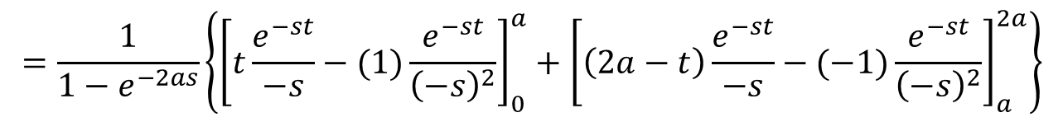
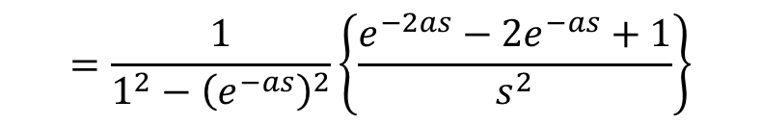
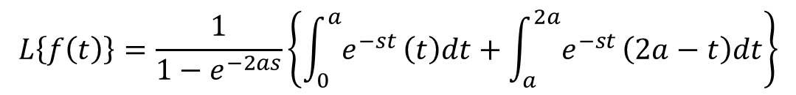
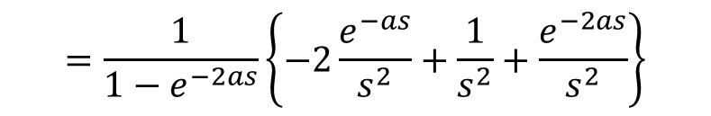
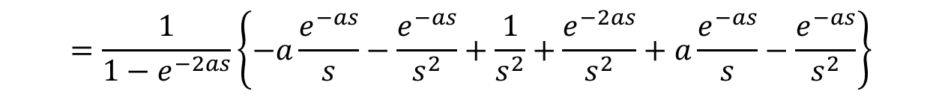
Example cont…
$$L\left\{f\left(t\right)\right\}=\frac{1}{1−e^{−2as}}\left\{\int_{0}^{a}{e^{−st}}\left(t\right)dt+\int_{a}^{2a}{e^{−st}}\left(2a−t\right)dt\right\}$$
$$=\frac{1}{1−e^{−2as}}\left\{{\left[t\frac{e^{−st}}{−s}−(1)\frac{e^{−st}}{{\left(−s\right)}^{2}}\right]}_{0}^{a}+{\left[\left(2a−t\right)\frac{e^{−st}}{−s}−(−1)\frac{e^{−st}}{{\left(−s\right)}^{2}}\right]}_{a}^{2a}\right\}$$
$$=\frac{1}{1−e^{−2as}}\left\{\left[a\frac{e^{−as}}{−s}−(1)\frac{e^{−as}}{{\left(−s\right)}^{2}}\right]−\left[0−\left(1\right)\frac{1}{{\left(−s\right)}^{2}}\right]+\left[0−\left(−1\right)\frac{e^{−2as}}{{\left(−s\right)}^{2}}\right]−\left[a\frac{e^{−as}}{−s}−(−1)\frac{e^{−as}}{{\left(−s\right)}^{2}}\right]\right\}$$
$$=\frac{1}{1−e^{−2as}}\left\{−a\frac{e^{−as}}{s}−\frac{e^{−as}}{s^{2}}+\frac{1}{s^{2}}+\frac{e^{−2as}}{s^{2}}+a\frac{e^{−as}}{s}−\frac{e^{−as}}{s^{2}}\right\}$$
$$=\frac{1}{1−e^{−2as}}\left\{−2\frac{e^{−as}}{s^{2}}+\frac{1}{s^{2}}+\frac{e^{−2as}}{s^{2}}\right\}$$
$$=\frac{1}{1^{2}−{\left(e^{−as}\right)}^{2}}\left\{\frac{e^{−2as}−{2e}^{−as}+1}{s^{2}}\right\}$$

Slide 11
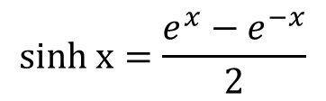
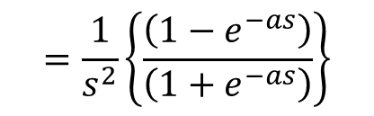
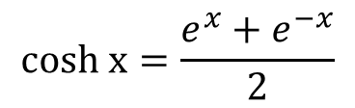
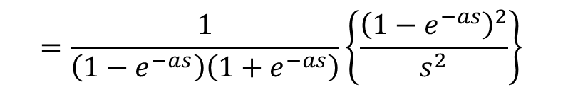
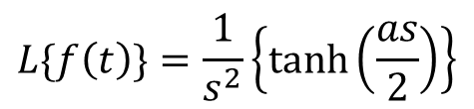
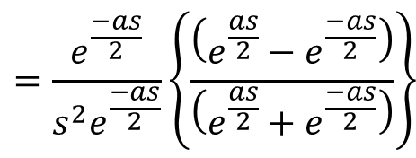
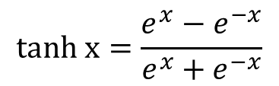
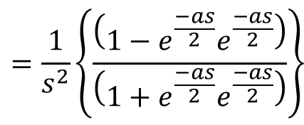
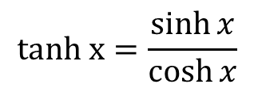
Example cont…
$$cosh x=\frac{e^{x}+e^{−x}}{2}$$
$$=\frac{1}{\left(1−e^{−as}\right)\left(1+e^{−as}\right)}\left\{\frac{{\left(1−e^{−as}\right)}^{2}}{s^{2}}\right\}$$
$$sinh x=\frac{e^{x}−e^{−x}}{2}$$
$$=\frac{1}{s^{2}}\left\{\frac{\left(1−e^{−as}\right)}{\left(1+e^{−as}\right)}\right\}$$
$$tanh x=\frac{\sinh{x}}{\cosh{x}}$$
$$=\frac{1}{s^{2}}\left\{\frac{\left(1−e^{\frac{−as}{2}}e^{\frac{−as}{2}}\right)}{\left(1+e^{\frac{−as}{2}}e^{\frac{−as}{2}}\right)}\right\}$$
$$tanh x=\frac{e^{x}−e^{−x}}{e^{x}+e^{−x}}$$
$$=\frac{e^{\frac{−as}{2}}}{s^{2}e^{\frac{−as}{2}}}\left\{\frac{\left(e^{\frac{as}{2}}−e^{\frac{−as}{2}}\right)}{\left(e^{\frac{as}{2}}+e^{\frac{−as}{2}}\right)}\right\}$$
$$L\{f\left(t\right)\}=\frac{1}{s^{2}}\left\{\tanh\left(\frac{as}{2}\right)\right\}$$

Slide 12
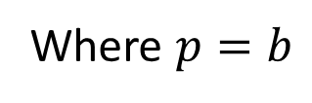
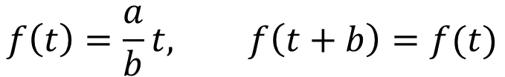
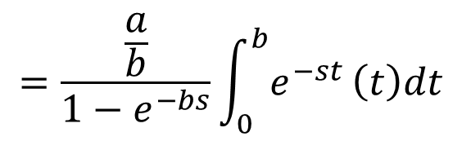
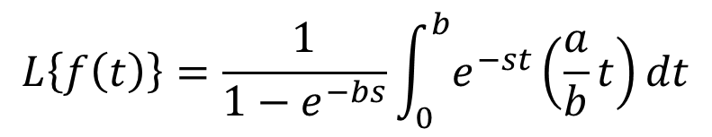
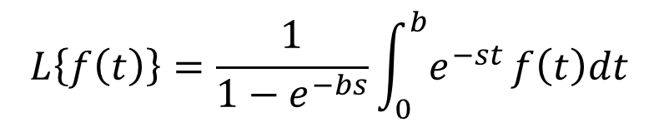
Example
2. Find the Laplace Transform of saw-tooth wave function
Ans:
We have
$$f\left(t\right)=\frac{a}{b}t, f\left(t+b\right)=f(t)$$
and
$$L\left\{f\left(t\right)\right\}=\frac{1}{1−e^{−bs}}\int_{0}^{b}{e^{−st}}f\left(t\right)dt$$
Where $p=b$
$$L\left\{f\left(t\right)\right\}=\frac{1}{1−e^{−bs}}\int_{0}^{b}{e^{−st}}\left(\frac{a}{b}t\right)dt$$
$$=\frac{\frac{a}{b}}{1−e^{−bs}}\int_{0}^{b}{e^{−st}}\left(t\right)dt$$

Slide 13
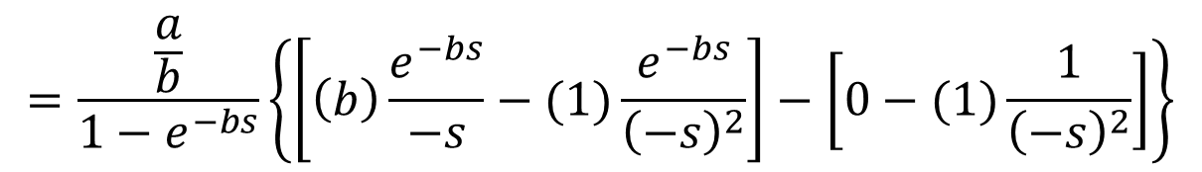
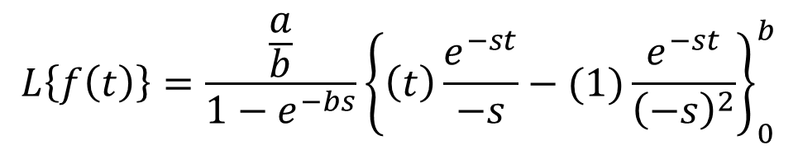
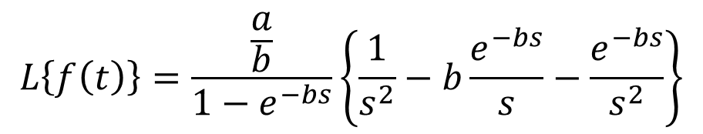
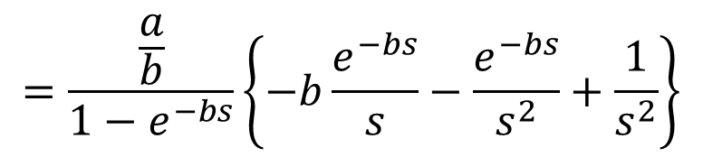
Example cont…
$$L\left\{f\left(t\right)\right\}=\frac{\frac{a}{b}}{1−e^{−bs}}{\left\{\left(t\right)\frac{e^{−st}}{−s}−(1)\frac{e^{−st}}{{\left(−s\right)}^{2}}\right\}}_{0}^{b}$$
$$=\frac{\frac{a}{b}}{1−e^{−bs}}\left\{\left[\left(b\right)\frac{e^{−bs}}{−s}−(1)\frac{e^{−bs}}{{\left(−s\right)}^{2}}\right]−\left[0−(1)\frac{1}{{\left(−s\right)}^{2}}\right]\right\}$$
$$=\frac{\frac{a}{b}}{1−e^{−bs}}\left\{−b\frac{e^{−bs}}{s}−\frac{e^{−bs}}{s^{2}}+\frac{1}{s^{2}}\right\}$$
$$L\left\{f\left(t\right)\right\}=\frac{\frac{a}{b}}{1−e^{−bs}}\left\{\frac{1}{s^{2}}−b\frac{e^{−bs}}{s}−\frac{e^{−bs}}{s^{2}}\right\}$$

Slide 14
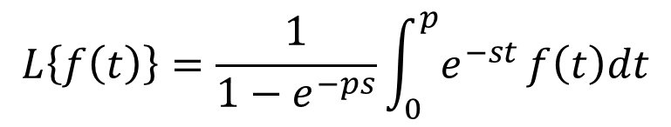
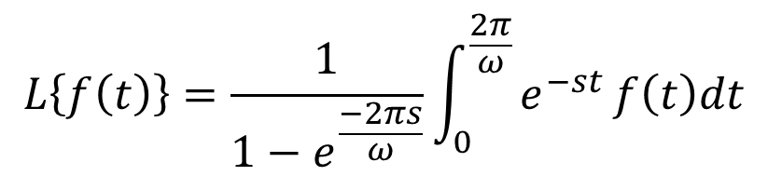
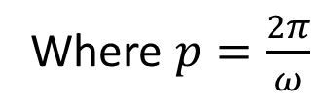
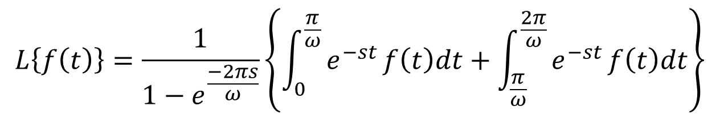
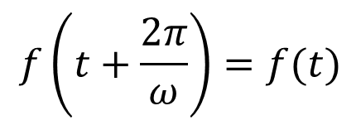
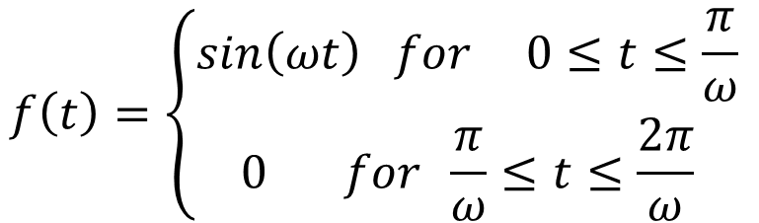
Example
3. Find the Laplace Transform of half-wave rectifier function
Ans:
$$f\left(t\right)=\left\{\begin{aligned}sin\left(ωt\right) for 0≤t≤\frac{π}{ω} \\ 0 for \frac{π}{ω}≤t≤\frac{2π}{ω}\end{aligned} \right.$$
$$f\left(t+\frac{2π}{ω}\right)=f(t)$$
We have
and
$$L\left\{f\left(t\right)\right\}=\frac{1}{1−e^{−ps}}\int_{0}^{p}{e^{−st}}f\left(t\right)dt$$
Where $p=\frac{2π}{ω}$
$$L\left\{f\left(t\right)\right\}=\frac{1}{1−e^{\frac{−2πs}{ω}}}\int_{0}^{\frac{2π}{ω}}{e^{−st}}f\left(t\right)dt$$
$$L\left\{f\left(t\right)\right\}=\frac{1}{1−e^{\frac{−2πs}{ω}}}\left\{\int_{0}^{\frac{π}{ω}}{e^{−st}}f\left(t\right)dt+\int_{\frac{π}{ω}}^{\frac{2π}{ω}}{e^{−st}}f\left(t\right)dt\right\}$$

Slide 15
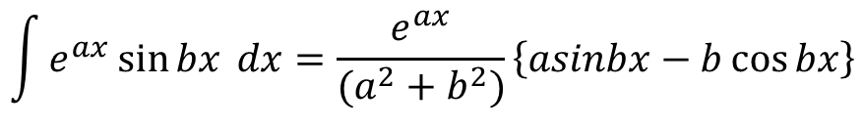
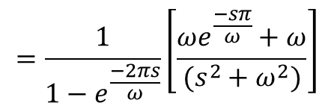
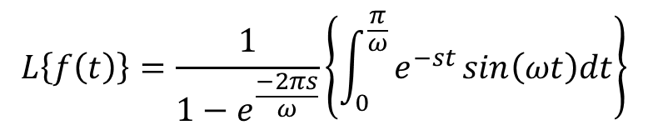
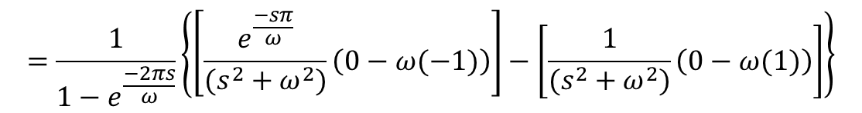


Example cont…
$$L\left\{f\left(t\right)\right\}=\frac{1}{1−e^{\frac{−2πs}{ω}}}\left\{\int_{0}^{\frac{π}{ω}}{e^{−st}}sin\left(ωt\right)dt+\int_{\frac{π}{ω}}^{\frac{2π}{ω}}{e^{−st}}(0)dt\right\}$$
$$L\left\{f\left(t\right)\right\}=\frac{1}{1−e^{\frac{−2πs}{ω}}}\left\{\int_{0}^{\frac{π}{ω}}{e^{−st}}sin\left(ωt\right)dt\right\}$$
$$\int{e^{ax}\sin{bx }dx}=\frac{e^{ax}}{(a^{2}+b^{2})}\left\{asinbx−b\cos{bx}\right\}$$
$$=\frac{1}{1−e^{\frac{−2πs}{ω}}}{\left\{\frac{e^{−st}}{(s^{2}+ω^{2})}\left[−s\sin{ωt−ω\cos{ωt}}\right]\right\}}_{0}^{\frac{π}{ω}}$$
$$=\frac{1}{1−e^{\frac{−2πs}{ω}}}\left\{\left[\frac{e^{\frac{−sπ}{ω}}}{(s^{2}+ω^{2})}\left(0−ω(−1)\right)\right]−\left[\frac{1}{(s^{2}+ω^{2})}\left(0−ω(1)\right)\right]\right\}$$
$$=\frac{1}{1−e^{\frac{−2πs}{ω}}}\left[\frac{{ωe}^{\frac{−sπ}{ω}}+ω}{(s^{2}+ω^{2})}\right]$$

Slide 16




Example cont…
$$L\left\{f\left(t\right)\right\}=\frac{ω}{1−e^{\frac{−2πs}{ω}}}\left[\frac{e^{\frac{−sπ}{ω}}+1}{(s^{2}+ω^{2})}\right]$$
$$=\frac{ω}{1^{2}−{\left(e^{\frac{−πs}{ω}}\right)}^{2}}\left[\frac{{1+e}^{\frac{−sπ}{ω}}}{(s^{2}+ω^{2})}\right]$$
$$=\frac{ω}{\left({1+e}^{\frac{−sπ}{ω}}\right)\left({1−e}^{\frac{−sπ}{ω}}\right)}\left[\frac{{1+e}^{\frac{−sπ}{ω}}}{(s^{2}+ω^{2})}\right]$$
$$L\left\{f\left(t\right)\right\}=\frac{ω}{(s^{2}+ω^{2})\left({1−e}^{\frac{−sπ}{ω}}\right)}$$

Slide 17






Example
4. Find the Laplace Transform of full-wave rectifier function
Ans:
$$f\left(t+\frac{π}{ω}\right)=f(t)$$
and
We have
$$f\left(t\right)=sin\left(ωt\right)$$
$$L\left\{f\left(t\right)\right\}=\frac{1}{1−e^{−ps}}\int_{0}^{p}{e^{−st}}f\left(t\right)dt$$
Where $p=\frac{π}{ω}$
$$L\left\{f\left(t\right)\right\}=\frac{1}{1−e^{\frac{−πs}{ω}}}\left\{\int_{0}^{\frac{π}{ω}}{e^{−st}}sin\left(ωt\right)dt\right\}$$
$$=\frac{1}{1−e^{\frac{−πs}{ω}}}{\left\{\frac{e^{−st}}{(s^{2}+ω^{2})}\left[−s\sin{ωt−ω\cos{ωt}}\right]\right\}}_{0}^{\frac{π}{ω}}$$

Slide 18






Example cont…
$$=\frac{1}{1−e^{\frac{−πs}{ω}}}\left\{\left[\frac{e^{\frac{−sπ}{ω}}}{(s^{2}+ω^{2})}\left(0−ω(−1)\right)\right]−\left[\frac{1}{(s^{2}+ω^{2})}\left(0−ω(1)\right)\right]\right\}$$
$$=\frac{1}{1−e^{\frac{−πs}{ω}}}\left[\frac{{ωe}^{\frac{−sπ}{ω}}+ω}{(s^{2}+ω^{2})}\right]$$
$$=\frac{ω}{(s^{2}+ω^{2})}\left[\frac{1+e^{\frac{−sπ}{ω}}}{1−e^{\frac{−πs}{ω}}}\right]$$
$$L\{f\left(t\right)\}=\frac{ω}{(s^{2}+ω^{2})}coth\left(\frac{sπ}{2ω}\right)$$
$$=\frac{ω}{(s^{2}+ω^{2})}\left\{\frac{\left(1+e^{\frac{−sπ}{2ω}}e^{\frac{−sπ}{2ω}}\right)}{\left(1−e^{\frac{−sπ}{2ω}}e^{\frac{−sπ}{2ω}}\right)}\right\}$$
$$=\frac{ω}{(s^{2}+ω^{2})}\frac{e^{\frac{−sπ}{2ω}}}{e^{\frac{−sπ}{2ω}}}\left\{\frac{\left(e^{\frac{sπ}{2ω}}+e^{\frac{−sπ}{2ω}}\right)}{\left(e^{\frac{sπ}{2ω}}−e^{\frac{−sπ}{2ω}}\right)}\right\}$$

Slide 19
Problems for practice
1. Find the Laplace Transform of rectangular wave function
2. Find the Laplace Transform of square wave function
3. Find the Laplace Transform of staircase function

Slide 20


